Slide 1

AI-CADEMIC
Summer 2024 Gen-AI Hackathon
Ariel Azria & Daniel Sa

Slide 2
Purpose and Problem Statement
Hackathon goal: develop a model that parses images, tables, figures, and text from academic papers to query via RAG
Generalized goal: develop a technique that enables users to query multimodal data stored in a RAG database through a chatbot. Result is to streamline information retrieval by creating vector databases containing unstructured data
Notes:
Basically, we wanted to create something that would allow us to create a special kind of database so we could search by “meaning” not just keywords, and that a chatbot would be the interface for.

Slide 3
Academic Literature – Ingesting Multimodal Data
There are two main approaches to ingesting multimodal data discussed in literature today, with most scholars exploring:
MM-LLMs, or “multimodal large language models” that empower multimodal tasks. Explosion in interest in 2023 onwards.
Pros: high-quality text output
Cons: difficulty in aligning human intent with produced output
Prior to 2023, the researchers focused on deep learning models based on DBN, SAE, CNN, and RNN
Pros: state-of-the-art prior to LLMs, improved high-performance computing devices allowed efficient training
Cons: mostly use backpropagation algorithms, making training time-intensive

Slide 4
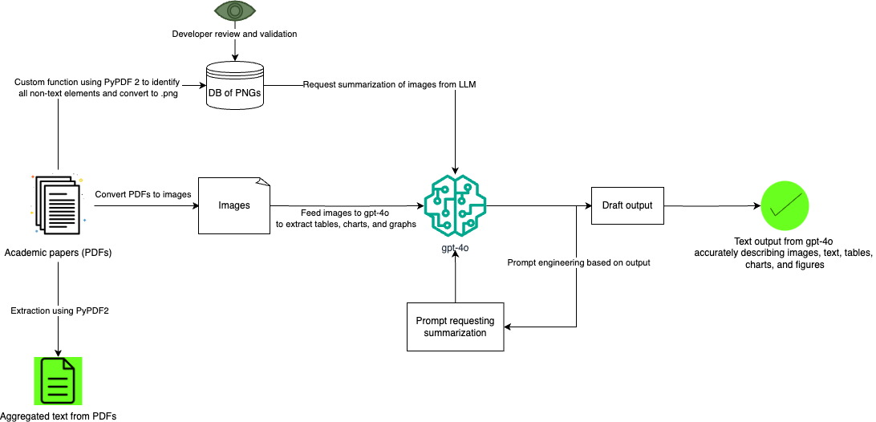


Our Approach For Ingesting Multimodal Data: A Transformer-Based LLM

Slide 5
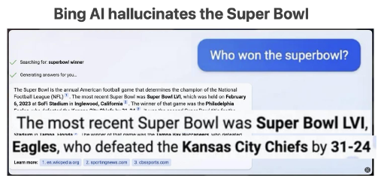
Example of Transformation
The image contains the text "Bing AI hallucinates the Super Bowl" in large, bold font. This suggests a focus on an incident or scenario involving Bing AI generating or imagining information related to the Super Bowl.
Prompt:
Here is an image of a page from a pdf, identify any diagrams, graphics, equations, or tables within the image and ignore the basic text of the paper. Represent the data in the table as text in a structured form. Describe and summarize graphics and diagrams and transcribe equations. Give the data back in a simple format as it will be passed directly back to a database

Slide 6
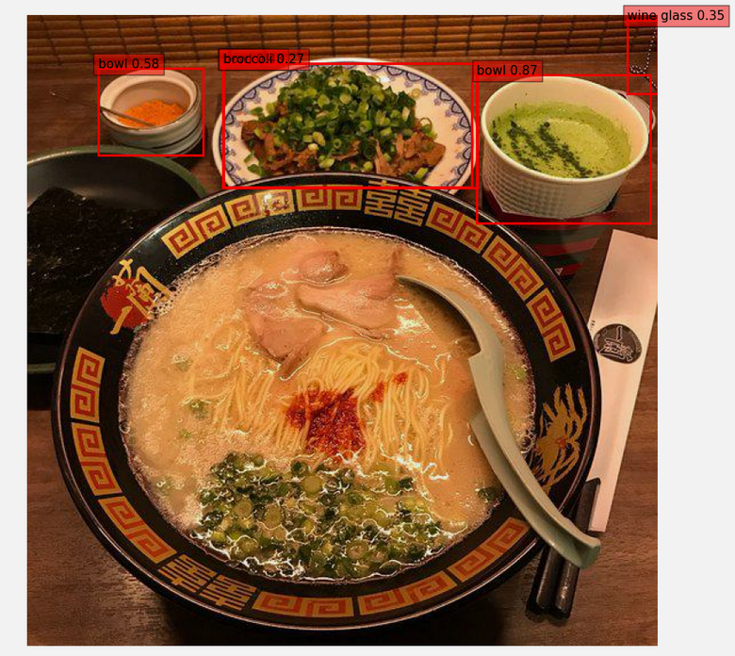
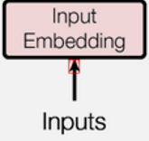
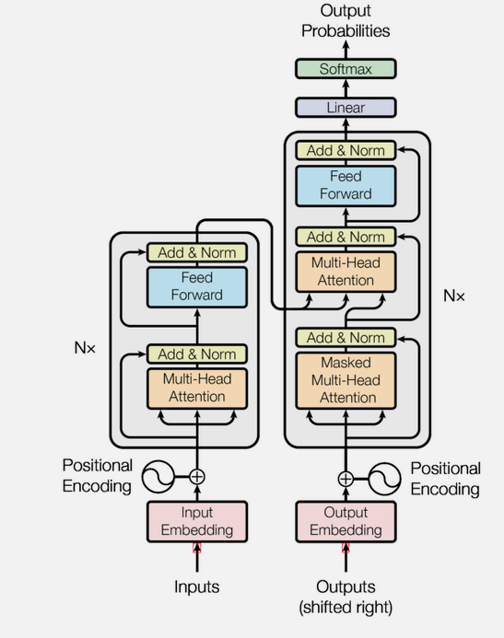
Examples of Failed Multimodal Extraction
This red square was the only recognized entity when using FASTER_RCNN
Examples of failed item recognition

Slide 7
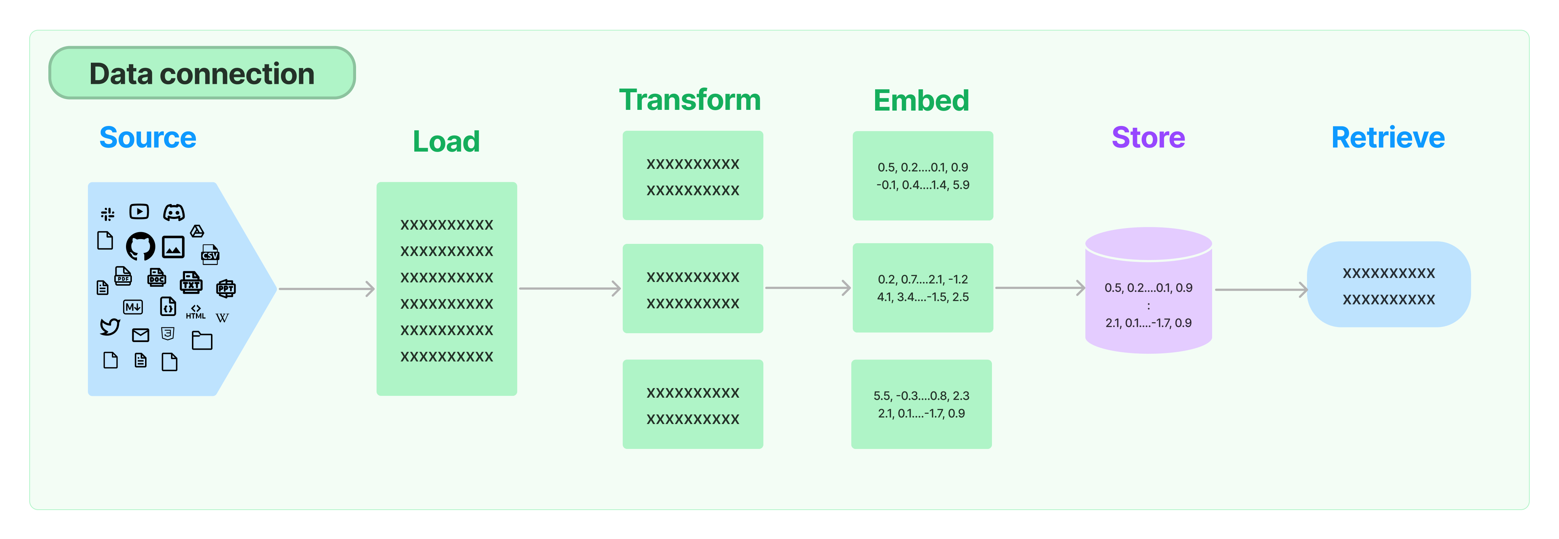

The Journey from Text to Vector Database
We are here
Figure source: https://js.langchain.com/v0.1/docs/modules/data_connection/

Slide 8
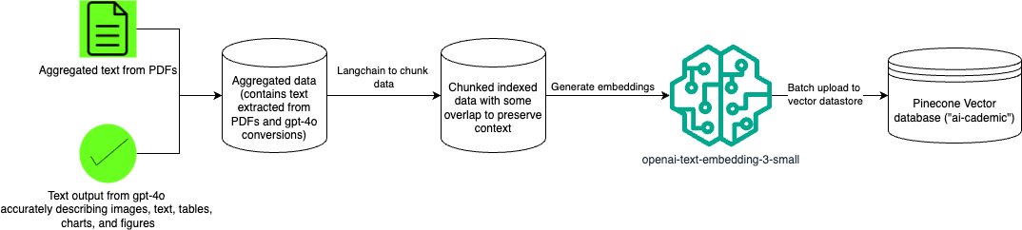
Loading and Transforming The Data

Slide 9
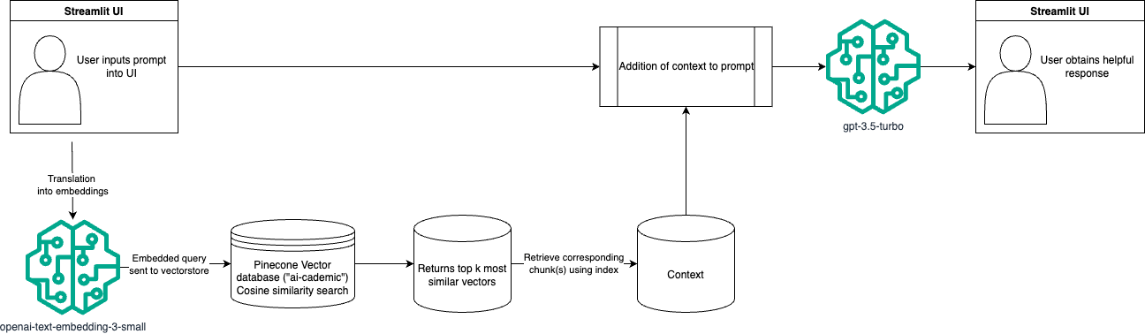
Querying The Vector Database

Slide 10
Models & Cost
Model Used | Purpose | Logic for choice | Accrued Cost | Sustainable? | Scalable?
gpt 4-o | Summarization of multimodal data | Multimodal model known for vision capabilities | $3.14 | N/A – this was a one-time use | No
openai-text-embedding-3-small | Generate text embeddings of data and user query | Inexpensive, fast, high-performing embedding model | <$0.01 | Yes | Yes – 65,000 pages per $1
gpt-3.5-turbo | Interpret user query and context to generate a useful response | Fast, inexpensive model optimized for use-case (dialogue) | $0.22 | Yes | Small-scale

Slide 11

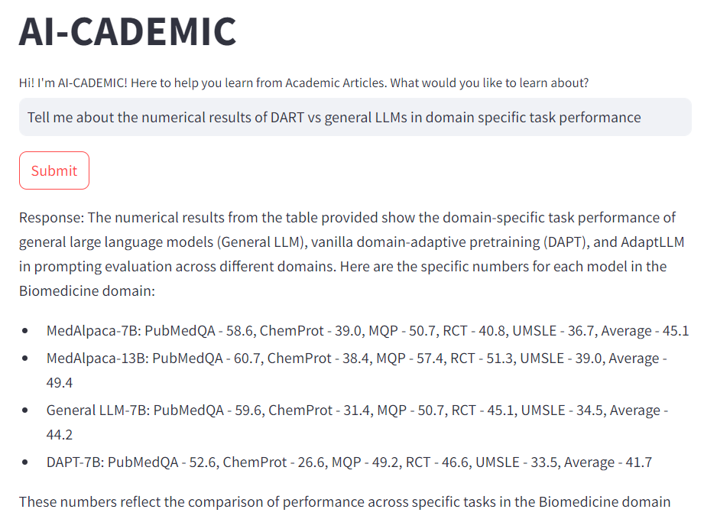
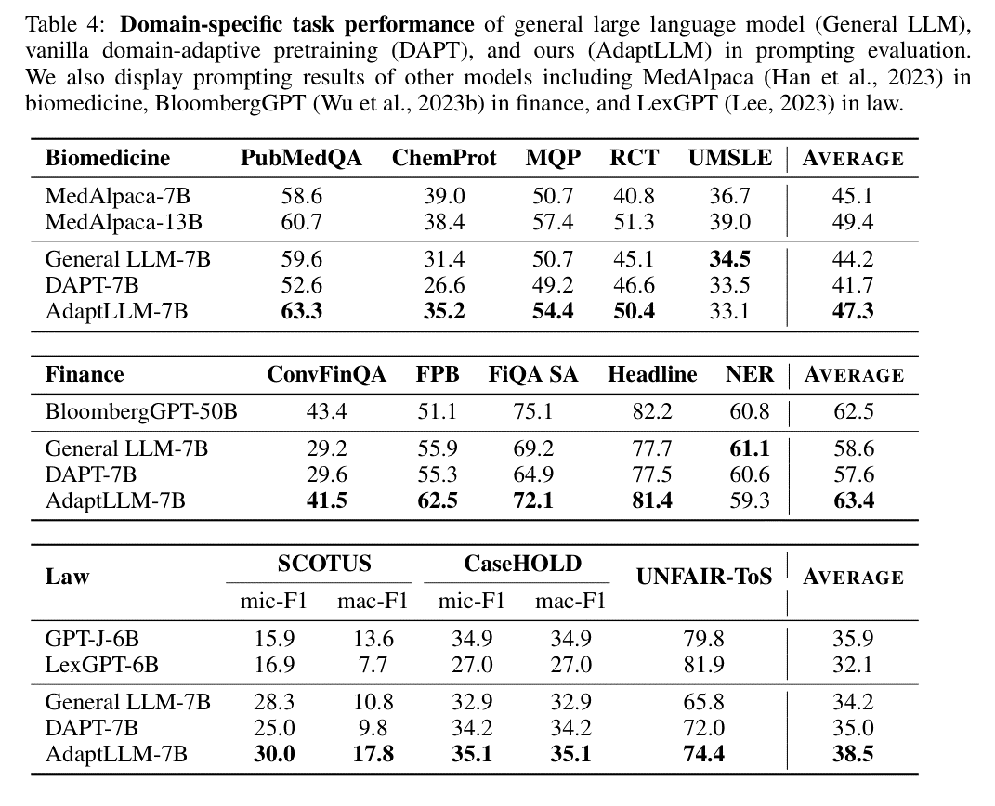


Promising Initial Results
Screenshots here

Slide 12
Evaluation: Test Cases Approach
Evaluated results across 3 data types:
Text, images/charts, tables
Types of prompts evaluated:
Extraction: “What is the main hypothesis/idea...”
Summarization: “Summarize key findings on …”
Dual prompting: “Describe [XYZ]. What does [XYZ] indicate?”
Idea generation: “Integrate findings on [topic] to propose a new idea/research direction/hypothesis”
Scoring metrics [-1 (negative) | 0 (neutral) 1 (positive)]
Coherence: is the returned text coherent?
Accuracy: does the response accurately reflect information in the articles?
Relevance: does the output answer the user’s question?
Use of Chat GPT-4o and human judgment to score
Human judgement only used to decrease scores, not increase to avoid tester bias

Slide 13

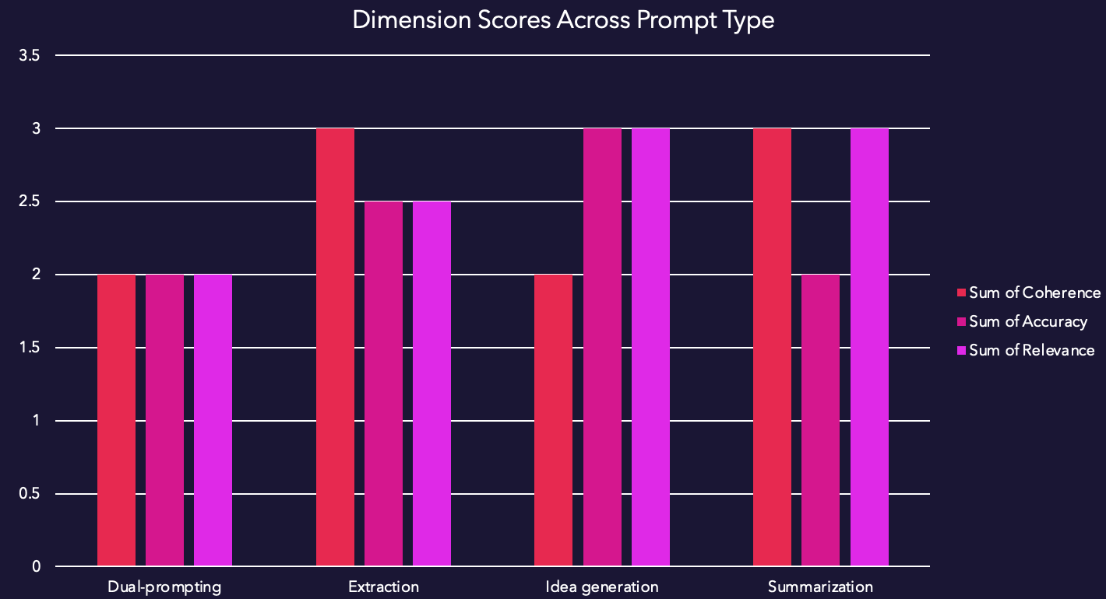
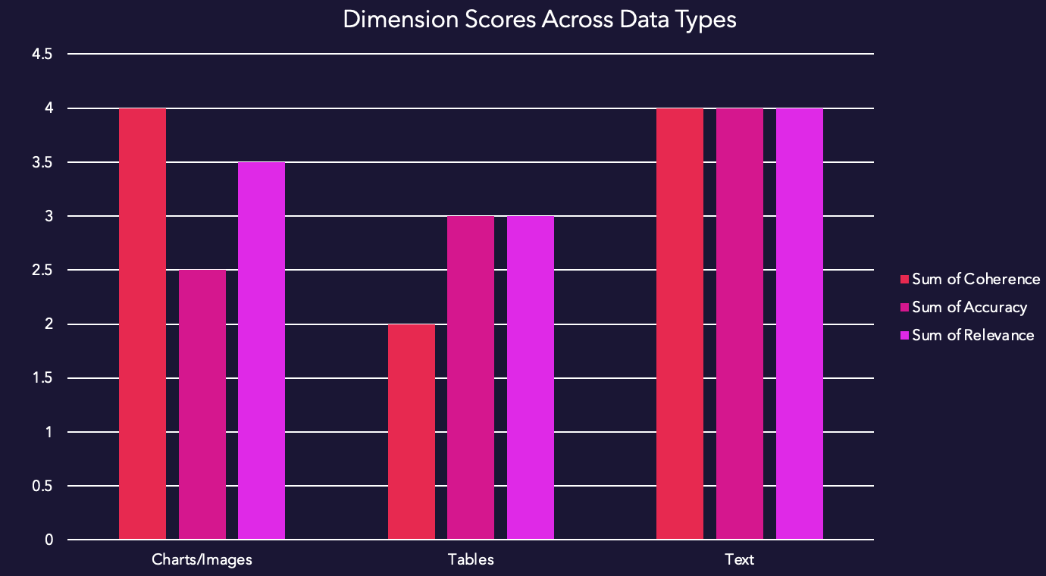
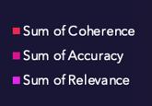
Results: Stellar on Text, Otherwise Average

Slide 14
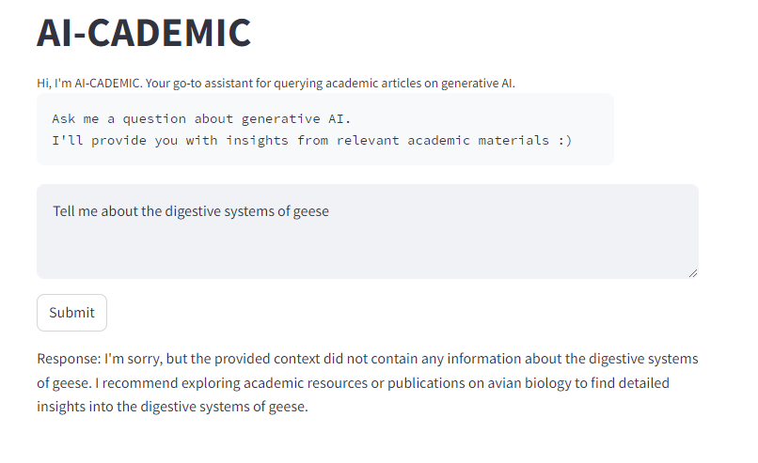
Safeguards against hallucinations, and not falling back on the model’s foundations

Slide 15
Next steps
Focus on images: Convert images to text using an open-source CV model, potentially with the use of ASCII
Eye on cost: Evaluate open-source models for embedding generation and querying to reduce cost without sacrificing performance
Enable scalability: Create an ingestion script to easily add articles to Pinecone database (front and back-end)
Enhance user experience: Allow users to ask model follow-up questions

Slide 16
Sources
Gao, Jing, Peng Li, Zhikui Chen, and Jianing Zhang. “A Survey on Deep Learning for Multimodal Data Fusion.” Neural Computation 32, no. 5 (May 1, 2020): 829–64. https://doi.org/10.1162/neco_a_01273.
Zhang, Duzhen, Yahan Yu, Jiahua Dong, Chenxing Li, Dan Su, Chenhui Chu, and Dong Yu. “MM-LLMs: Recent Advances in MultiModal Large Language Models.” arXiv, May 28, 2024. https://doi.org/10.48550/arXiv.2401.13601.

Slide 17
Appendix

Slide 18
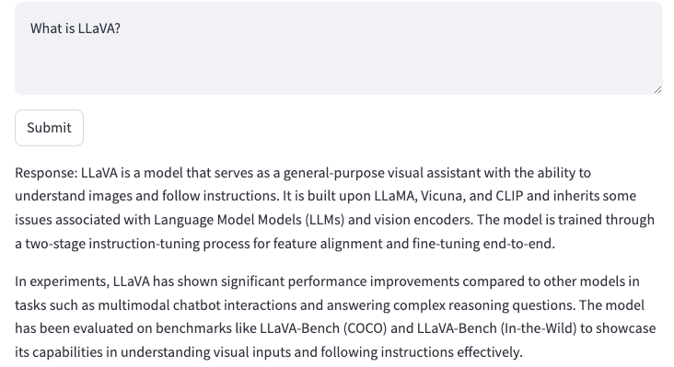
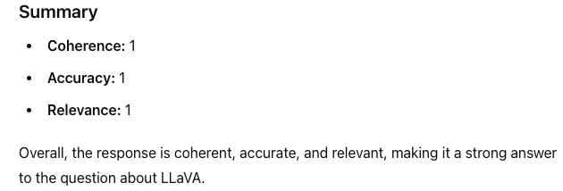
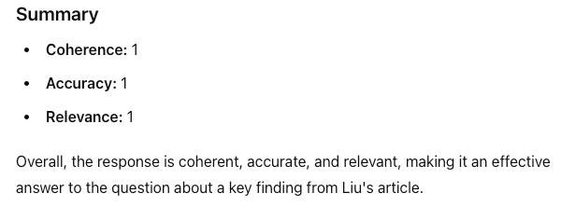
Text Test Cases - EXTRACTION
Prompts:
“Identify one key finding from Liu's article” (score = 3)
“What is LLaVA?” (score = 3)
Adapting Large Language Models via Reading Comprehension (1)

Slide 19
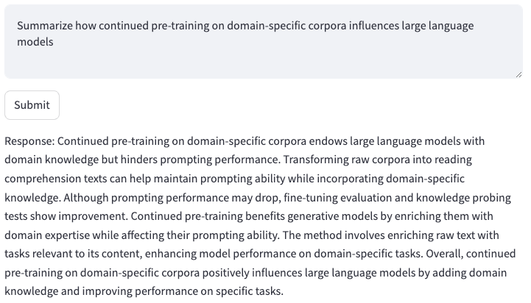
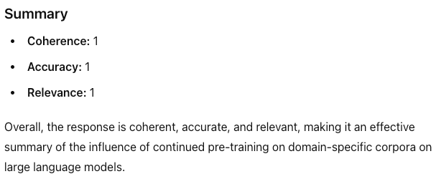
Text Test Cases - SUMMARIZATION
Prompt: “Summarize how continued pre-training on domain-specific corpora influences large language models.”
Adapting Large Language Models via Reading Comprehension (1)

Slide 20
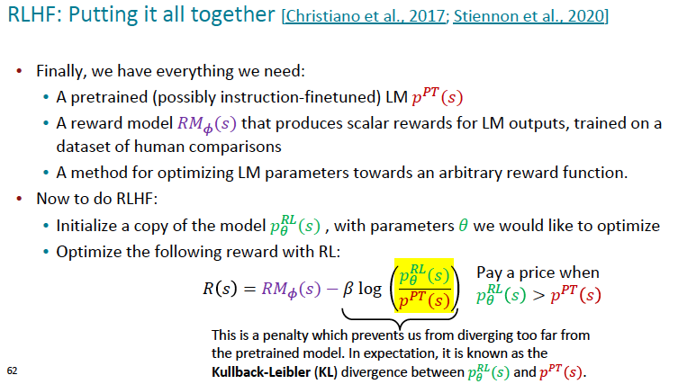
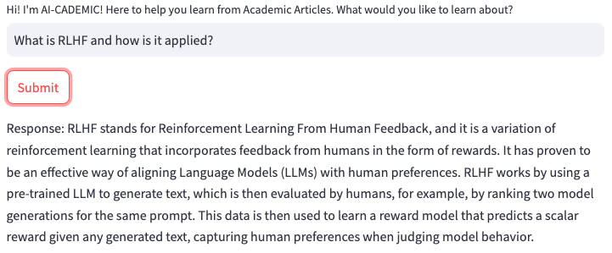
Text Test Cases – DUAL PROMPTING
Prompt: “What is RLHF? Summarize it, and then explain how it is applied.”
PowerPoint Presentation

Slide 21
Text Test Cases – IDEA GENERATION
Prompt: “Integrate the findings from pre-training on domain-specific corpora and the relationship between CLMs and PLMs to propose a new research direction or hypothesis. Justify your proposal based on the evidence provided in the articles.”
Adapting Large Language Models via Reading Comprehension (1)

Slide 22
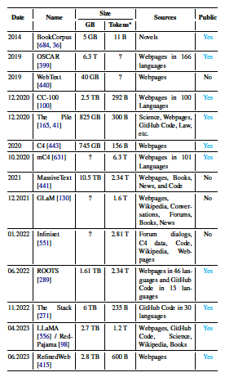
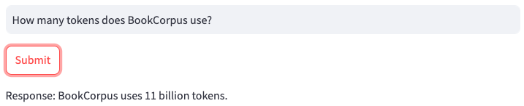
Table Test Cases - EXTRACTION
Prompt: “How many tokens does BookCorpus use?”
Challenges LLM (3)

Slide 23
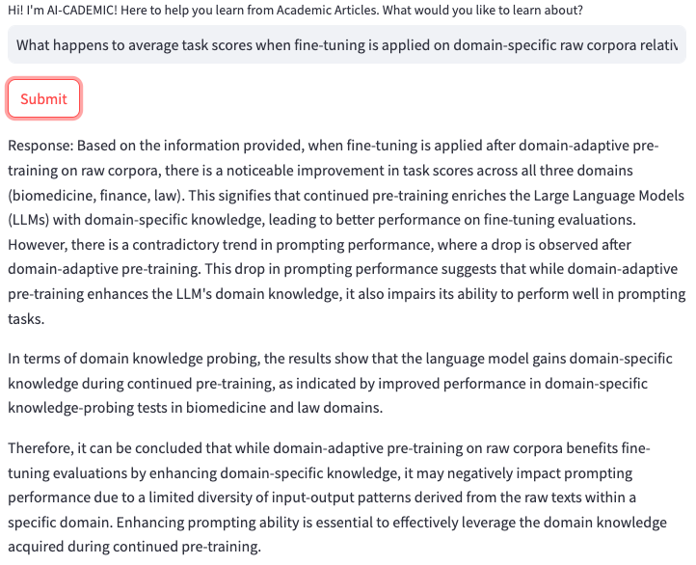
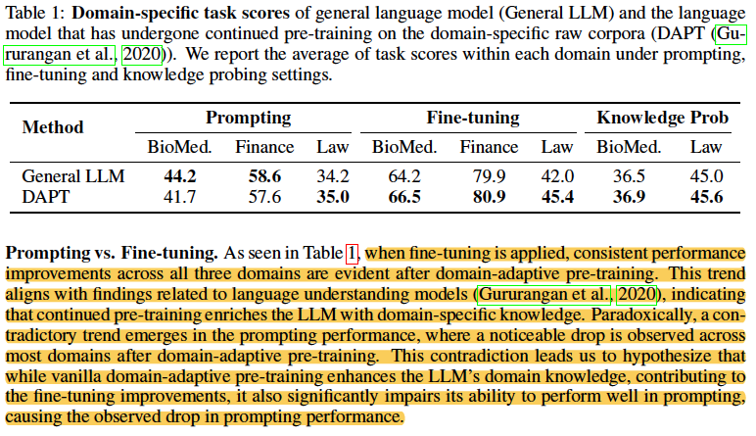
Table Test Cases - SUMMARIZATION
Prompt: “What happens to average task scores when fine-tuning is applied on domain-specific raw corpora relative to General LLMs?”
Continual pre-training paper (3)

Slide 24
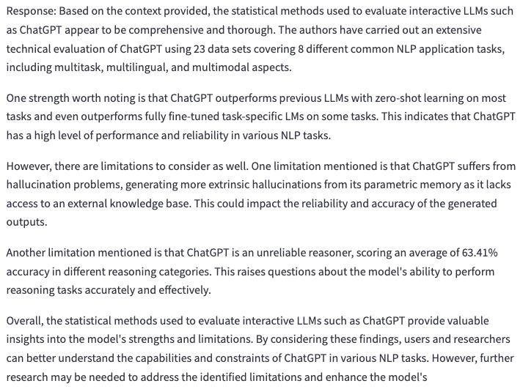
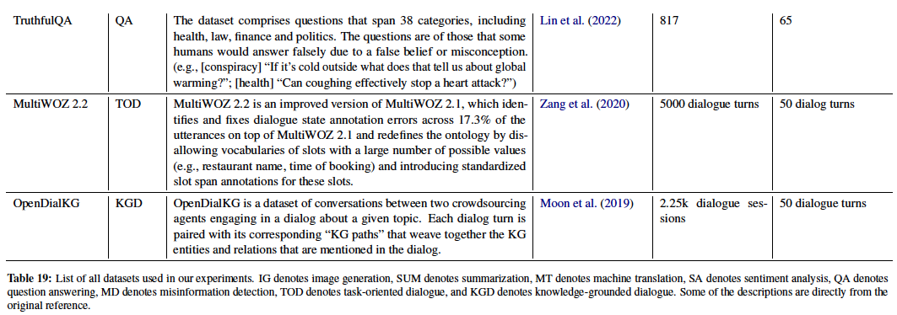
Table Test Cases – DUAL PROMPTING
Prompt: “Critically evaluate the statistical methods used to evaluate interactive LLMs such as ChatGPT. Are there any limitations or strengths worth noting?”
Performance Evaluation, table extract from table pages 35-39

Slide 25
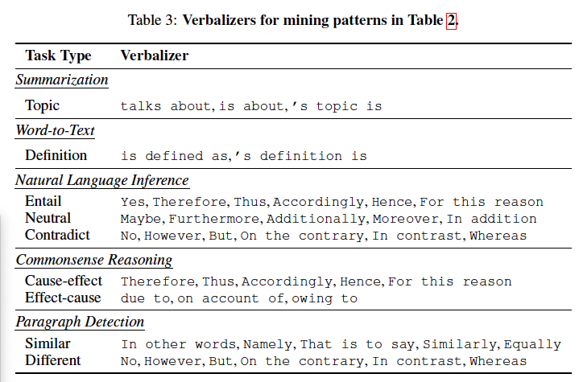
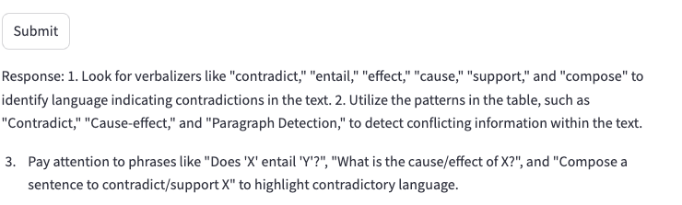
Table Test Cases – IDEA GENERATION
Prompt: “Based on examples of verbalizers for mining patterns you have in the context, generate a few ideas to help detect contradictory language.”
Continual pre-training paper (6)

Slide 26
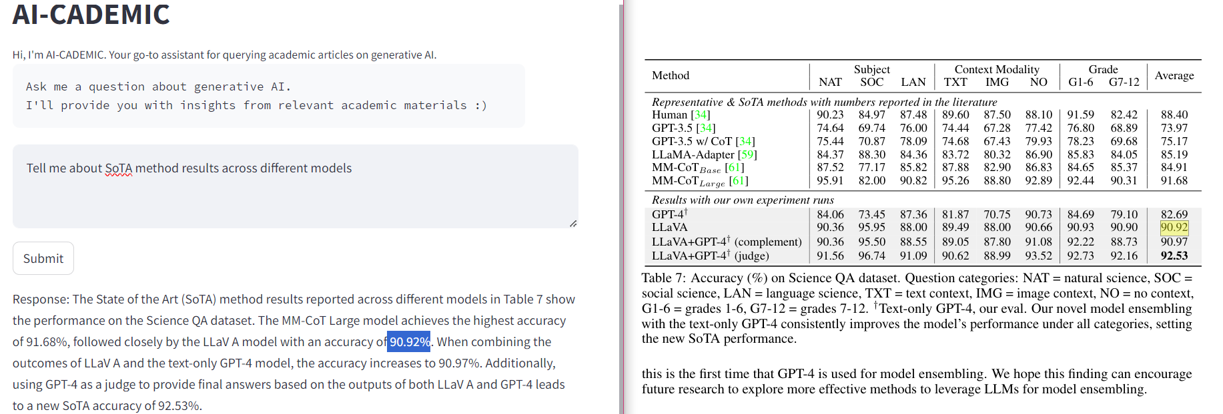
The AI-CADEMIC model's response is coherent, accurate, and relevant to the user's query, receiving a score of 1 in all evaluation dimensions.

Slide 27
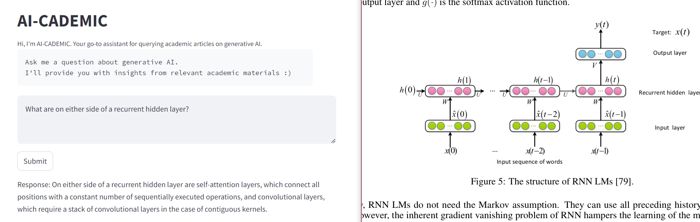

Hallucinations when recalling diagrams
The AI-CADEMIC model's response is somewhat coherent but fails in accuracy and relevance, receiving a score of 0 for coherence and -1 for both accuracy and relevance.

Slide 28
Charts/Images Test Cases – DUAL PROMPTING
Prompt: “Can you describe the main features of the attention mechanism diagram? Additionally, what does this diagram illustrate about the role of self-attention in transformer models?”
Response: The attention mechanism diagram typically illustrates how different positions in a sequence are related through attention weights. It shows connections between words or symbols in a sequence, highlighting which parts are given more importance or influence during computation. This diagram demonstrates the self-attention mechanism, which relates different positions within a single sequence to compute a representation of that sequence.
The diagram reveals the role of self-attention in transformer models by showcasing how the model can compute representations of its input and output solely through self-attention mechanisms without relying on recurrent or convolutional networks. This self-attention mechanism allows the transformer model to draw global dependencies between input and output, enabling more parallelization and efficient processing compared to models that rely on sequential computation. It also helps in capturing dependencies between distant positions in the input or output sequences, as shown by the attention heads attending to long-distance dependencies in the diagram.

Slide 29
Charts/Images Test Cases – IDEA GENERATION
Prompt: “Based on the images on the text, what research avenue would you explore to further improve LLM performance?”
Response: “Response: Given the images provided in the text, an avenue of research to further improve LLM performance could be exploring ways to address the issue of hallucinated distributions. This issue arises when LLMs are used to generate synthetic data, and it becomes challenging to verify if the data generated accurately represents the true distribution of real-world data. Research focused on methods to verify the representativeness of synthetic data generated by LLMs could help improve model performance and reduce the risk of model collapse.
Please let me know if you need more information or if you would like assistance with other research avenues.”

Slide 30
